Slide 2
PrEP Knowledge, Intention and Uptake Among MSM Geosocial Networking App Users in Mexico
Ian W. Holloway, Alex Garner, Jianchao Lai, Amy Ritterbusch, Sebastian Giraldo & Vincent Guilamo-Ramos
@ian_holloway
@AlexGarnerLA
Share your thoughts on this presentation with #IAS2019

Slide 3
PrEP Roll Out in Mexico
ImPrEP Project
Aims to contribute to increase PrEP uptake among high risk MSM and TGW, in Brazil, Mexico and Peru, contributing to increase PrEP adoption globally.
Funders: UNITAID, Goverments of Brazil, Peru, and Mexico and implementing partners
Implementation Challenges in ImPrEP study in Mexico
Plan was to enroll 3,000 people in Mexico
Reduction of number of cities from 8 to 3
New enrollment currently paused
Shortages of medication
Recent proposed funding changes by the Mexican Government
Climate of confusion among communities who can most benefit from PrEP
Notes:
Alex

Slide 4
Objective
The current study sought to achieve the following objectives:
Document PrEP knowledge, PrEP uptake, and intention to take PrEP in the next 6 months among men who have sex with men (MSM) in Mexico; and
Understand sociodemographic and social behavioral correlates of PrEP knowledge, PrEP uptake, and PrEP intention among MSM in Mexico.
The overarching goal of this work is to inform ongoing PrEP implementation efforts in Mexico among MSM.
Notes:
Alex

Slide 6
Methods
Between November 2018 and January 2019 we used targeted recruitment of Hornet users in over 500 cities across Latin America (LA)
3,781 surveys completed across LA
2,983 surveys collected from Mexico
Participants completed a brief online survey, which assessed:
Outcomes: PrEP knowledge, past 12 month and current PrEP use, and intention to use PrEP in the next 6 months
Other variables: Sociodemographic characteristics (geographic location, age), STI testing and diagnosis, illicit substance use (mephedrone, GHB/GBL, ketamine, meth), happiness with sex life (5 point Likert-type scale)
Multivariable logistic regression modeling used to determine correlates of PrEP knowledge, uptake and intention adjusting for relevant covariates

Slide 7
Survey Respondents
30
36
29
88
1,902
22
103
98
27
33
22

Slide 8
PrEP Users
60

Slide 9
HIV Status Results
Total analytic sample (N=2,491)
Excluded PLWH (16%; N=492)

Slide 10
Age Results
28.5%
29.1%
22.7%
13.1%
5.6%
0.9%
0.1%
18-25
26-30
31-40
41-50
51-60
61-70
70+

Slide 11
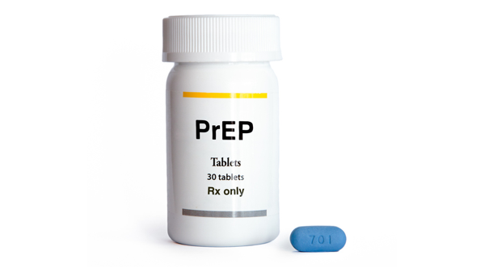
PrEP Knowledge
48%
11%
9%
6%
7%
5%
76%
have heard of PrEP
1%

Slide 12
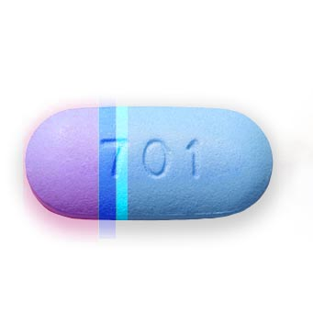
PrEP Uptake
6%
Other Sources
3.5%
Currently taking PrEP
6%
Friends
36%
8%
Internet
29%
Research studies
36%
5%
50%
Doctors
Intend to take PrEP in the next 6 months
Have taken PrEP in the last 12 months
5%

Slide 13
Social Behavioral Factors
5%
Unsure
8%
Diagnosed with an STI
In the past 12 months
65%
have been tested
for STIs
3.3%
report illicit drug use
87%
Not diagnosed
with an STI

Slide 14
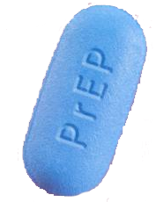
Social Behavioral Factors
4.27
77%
are happy or very happy
with their sex lives
3.96
P-value: 0.0024

Slide 15
Correlates of PrEP Knowledge
PrEP Knowledge | Odds Ratio | [95% Conf. | Interval]
Age (26-30, ref 18-25) | 1.77 | 1.33 | 2.37
Age (31-40, ref 18-25) | 1.83 | 1.38 | 2.42
Age (41+) | 0.96 | 0.71 | 1.30
STI testing | 2.13 | 1.72 | 2.64
Illicit substance use | 0.79 | 0.44 | 1.40
Sex life (satisfied/not satisfied) | 1.21 | 0.95 | 1.56

Slide 16
Correlates of PrEP Use
PrEPUse | Odds Ratio | [95% Conf. | Interval]
Age (26-30, ref 18-25) | 1.55 | 1.09 | 2.20
Age (31-40, ref 18-25) | 1.19 | 0.83 | 1.71
Age (41+, ref 18-25) | 2.10 | 1.45 | 3.03
KYS function | 0.97 | 0.75 | 1.26
STI testing | 6.99 | 4.33 | 11.30
Illicit substance use | 3.35 | 2.16 | 5.20
Sex life (satisfied/not satisfied) | 1.29 | 0.92 | 1.80

Slide 17
Correlates of Intention to Use PrEP
PrEP Intent | Odds Ratio | [95% Conf. | Interval]
Age (26-30, ref 18-25) | 1.05 | 0.80 | 1.37
Age (31-40, ref 18-25) | 0.81 | 0.62 | 1.06
Age (41+, ref 18-25) | 1.04 | 0.76 | 1.43
KYS function | 2.19 | 1.78 | 2.70
STI testing | 1.03 | 0.83 | 1.29
Illicit substance use | 2.05 | 1.18 | 3.55
Sex life (satisfied/not satisfied) | 1.20 | 0.94 | 1.54

Slide 18
Discussion
High PrEP knowledge
Low PrEP uptake
1/3 of sample intending to take PrEP in the next 6 months
Demand is high among MSM
Multiple structural barriers, including homophobia, continue to compromise access for vulnerable communities
PrEP users happy with their sex lives
Target younger people, use STI testing for PrEP information dissemination, illicit substance users continue to be a high priority population
KYS function and other social media are primary sources of information dissemination
Creative ways to leverage those platforms for PrEP information

Slide 19
Acknowledgements

Slide 20
¡Gracias!
Ian Holloway
Associate Professor
UCLA Luskin School of Public Affairs
holloway@luskin.ucla.edu
Alex Garner
Senior Health Innovation Strategist
Hornet
alex.garner@hornet.com

